Slide 1
Living JEA, Part 1: Author, Deploy, Enforce
Evgenij Smirnov
Notes:
This is the slide shown before the presentation starts. When you are ready to go, tell the video operator to start the recording, and click to the next slide.

Slide 2
5
Video operator, did you start the recording?
Notes:
[REQUIRED SLIDE]
These slides are mandatory and help us with video post-processing. Please keep them as they are.

Slide 3
4
Notes:
[REQUIRED SLIDE]

Slide 4
3
Notes:
[REQUIRED SLIDE]

Slide 5
2
Notes:
[REQUIRED SLIDE]

Slide 6
1
Notes:
[REQUIRED SLIDE]

Slide 7
Living JEA, Part 1: Author, Deploy, Enforce
Evgenij Smirnov
Notes:
Hi, and welcome to "Living JEA, Part One".

Slide 8
This Session
Look at JEA from the operations standpoint
Understand where the challenges lie
Wrap your head around concepts needed to overcome those
Become acquainted with a toolset available
Be aware of the limitations
Notes:
The plan here is to not look at JEA from the security point of view, which obviously isn't such a hard sell, but from the operational perspective, which is where in fact most challenges lie. We'll look at those in a moment and hopefully by the end of this session you'll be at least as far advanced as I am into overcoming those obstacles. And to further enable you to successfully implement JEA in your organisation or in your customers' environments, I'll share with you some tools I've made for the task. Everything shown here will be available on GitHub over the weekend. You'll be seeing very little PowerShell code, this I will amend in the next slot.
Now, for the sake of not losing my audience before we even get started: Is there anybody here in this room who has not at least a general understanding of what JEA is and how it works?

Slide 9
A problem with security tech
Security tech embedded in an underlying product tends to have little to none „human interface“ built into it.
SRP / AppLocker / WDAC
Windows Defender (unless you‘ve got SCCM)
BitLocker (unless you‘ve got MDOP → MBAM or SCCM)
JIT (unless you‘ve got MIM)
DSC (this is getting better, but hardly by any effort of MSFT‘s)
…and now JEA ☺

Slide 10
What we‘ve got

Slide 11
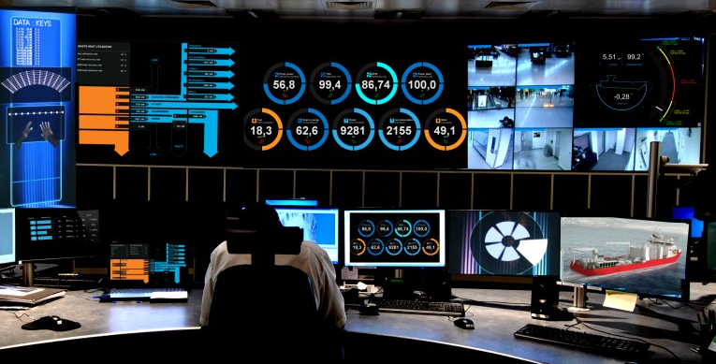
What they want need

Slide 12
JEA for Ops: Bridging the gap
Author
Deploy
Enforce
What is the main driver for my JEA deployment?
How does that translate to a JEA delivery model?
How do I create, reuse and keep track of JEA configs?
How do I register JEA configurations on all machines in a timely manner?
How can I integrate this in my deployment process?
What about rapid config changes?
Who has access to default endpoint (admin rights)?
Which endpoints has User X access to on Machine Y?
Is the JEA config on all machines as designed?

Slide 13
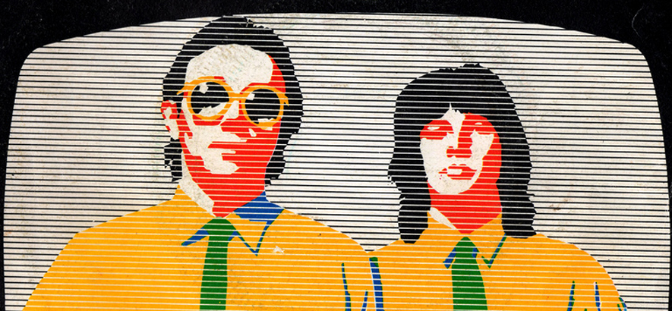
pwsh killed the JEA star…
Constrained Endpoints (→ JEA) are a feature of WSMan remoting

Slide 14
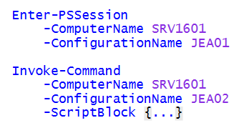
JEA Invocation Model

Slide 15
JEA Invocation Model

Slide 16
JEA Invocation Model

Slide 17
JEA Invocation Model

Slide 18
JEA Invocation Model

Slide 19
JEA Invocation Model - Highlights
JEA is a user-to-machine relationship.
endpoint selection is a conscious decision that has to be made by the invoker
role capabilities are flat text files that are stored in known locations and evaluated at each session setup (and only then).
role superposition works in a most lenient way. There is no concept of DENY in JEA.
there is one RunAs-Account for each endpoint.

Slide 20
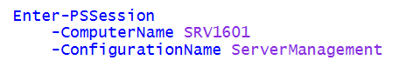
Canonical JEA delivery
Pro:
one endpoint to rule them all
zero change for new users
Contra:
role capabilities superposition
disconnect on config change
token lingering (JIT can help here)
token bloat potential

Slide 21
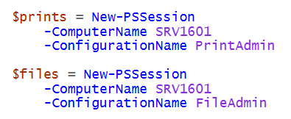
Role-centric JEA delivery
Pro:
less impact on config change
smaller footprint per machine
more homogenous definitions
zero change for new users
Contra:
multiple endpoints within one session
need to remember the names of potentially many endpoints

Slide 22
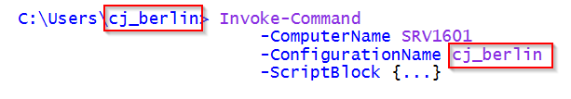
User-centric JEA delivery
Pro:
one endpoint to rule them all*
zero impact on config change**
no problem with token lingering or bloat
easier to check for config drift
Contra:
absolutely not manageable by humans
no separation of RunAs accounts
Notes:
* for each user ;-)
** for any other users ;-)

Slide 23
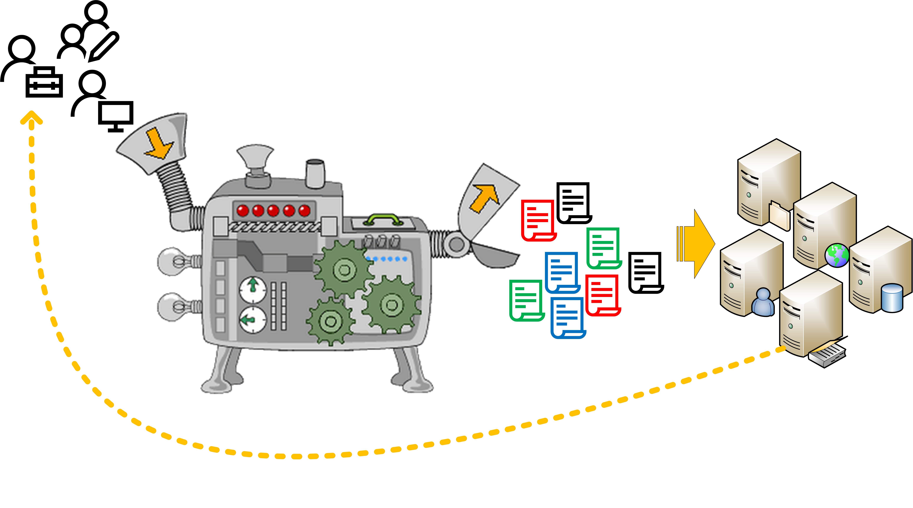
JEA deployment lifecycle

Slide 24
Let‘s build the magic I/O machine

Slide 25
Let‘s build the magic I/O machine

Slide 26
Let‘s build the magic I/O machine

Slide 27
A peek into the garage
DISCLAIMER: No production code ☹

Slide 28

Deploying JEA configurations
Direct push deployment:
copy Role Capabilities files to destination folders
register PS Remoting configuration
DSC: https://github.com/PowerShell/JEA
does pretty much the same ☺ but in a pull scenario
Use your organisation‘s configuration management
still needs to run Register-PSSessionConfiguration!
beware of WinRM restarts!

Slide 29
Battling configuration gaps / drift
Comparing running config to intent
works only if „intent“ is very well defined
requires a very advanced logic (with a distinct possibility of flaws in that)
…but if all works 100% correctly, yields 100% reliable results
Comparing running config to authored config
relatively simple and fast
relies on authoring mirroring „intent“ correctly
…but leaves a (relatively small) room for error

Slide 30
Checking for compliance

Slide 31
Further considerations
RunAs-Accounts → handling depends on delivery model
Transcript folders → handling depends on delivery model

Slide 32
Summary
Abstraction, automation and visual tools are a tremendous help in driving JEA adoption
The sum of all complexity remains the same but you can decide to offload parts of it onto the end users
You can (sort of) introduce DENY into role superposition
Regular compliance checks help combat configuration drift
Go grab a coffee and come back here for Part 2… …or switch to one of the other excellent talks
Notes:
Sum up your key messages

Slide 33
Notes:
[REQUIRED SLIDE]
Make sure you provide all materials that audience needs to reproduce your demos.
Either upload them as a PowerShell module to www.powershellgallery.com (preferred for reusable functions)
Or, upload them to our github repository (ask the girls at the info desk to provide you with access)
Or, upload them to your own github repository
Please make sure all materials are available by the time your presentation starts, or at minimum upload them right after your presentation

Slide 34
Notes:
[REQUIRED SLIDE]
If you sticked to your timing, you now have 15 min left for Q&A. If you missed your timing, you will have to leave the room when your slot is over. In this case, invite your audience to the coffee break and offer to cover questions there.
IN ANY CASE please point your audience to the conference app and the session voting. By the time the conference opens, the eventraft app *should* have the option to vote on sessions.
Please MAKE SURE you leave your room when your slot is over. The next speaker would like to set him/herself up and get everything up and running.

Slide 35
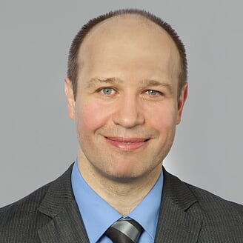
about_Speaker
Id: cj_berlin
DisplayName: Evgenij Smirnov
LocationBase: Berlin (DE)
Languages: {DE,EN,RU}
InfoURL: http://evgenij.smirnov.de
BlogURL: https://it-pro-berlin.de
EmployedAt: msg services ag
UserGroups: {“Windows Server User Group Berlin”,”Exchange User Group Berlin”}
Notes:
Do not EVER discuss this slide during your presentation. Please do not take presentation time to talk about yourself more than just a few introductory sentences. Instead, invite interested audience to the coffee break, and then talk about yourself, your job, your services, etc.
Use this slide to sum up your details. It will be part of the conference materials and recorded videos.

